Slide 1
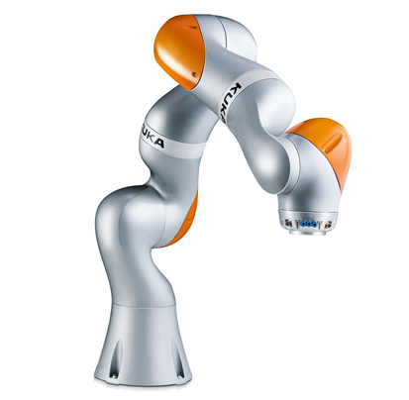



Inverse Kinematic controller
Candidate: Zafar Toshpulatov
Supervisor: Prof. Gianluca Antonelli

Slide 2
Overview
Project Goal
DH Notations
Kinematics
Finding Initial Joint Value
Inverse Kinematics Control Position only
Inverse Kinematics Control Position and Orientation
Inverse Kinematics Control Obstacle Avoiding
Results

Slide 3
Introduction Project Goal
Design an inverse kinematic controller to move end effector from position A to position B
1.Position Only
2.Position and Orientation
3.Obstacle Avoiding
Position and orientation Control

Slide 4
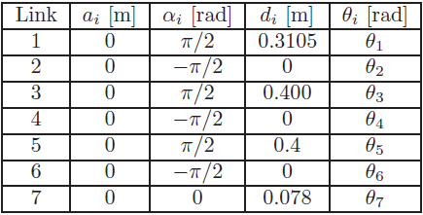
Implementation Denavit-Hartenberg (DH) Notation
Set of conventions used to represent a robot.
4 values required to describe a combination of joints:
a: Translation along x axis
α: Rotation along x axis
d: Translation along z axis
Ө: Rotation along z axis
Fig.1: DH table.

Slide 5
Implementation Kinematics
Kinematic model given the relation between the end-effector(EE) position and orientation and special position of the joint links
Direct kinematics
Joint Value EE Position
Joint Value EE Position
Inverse Kinematics

Slide 6
Implementation Finding Initial Joint values
Initialize DH values and time
Error
Input final end-effector position
J = Jacobian(DH)
T = Direct Kinematics
Joint velocity
dq = pinv(J)*K*error
Base to end-effector Homogeneous Transformation
Position
Quaternion
Position Error
Quaternion Error

Slide 7
Implementation Position Control
Initialize DH values, time and length
Trapezoidal velocity profile
Direct Kinematics
Position Error
Inverse Kinematics
J = Jacobian(DH)
Joint velocity
dq = pinv(J)*K*Position error

Slide 8
Implementation Position and Orientation Control
Initialize DH values, time and length
Direct Kinematics
T = Direct Kinematics
Position Error
Quaternion Error
Base to end-effector Homogeneous Transformation
Error
Inverse Kinematics
Trapezoidal velocity profile
J = Jacobian(DH)
Joint velocity
dq = pinv(J)*K*Error

Slide 9
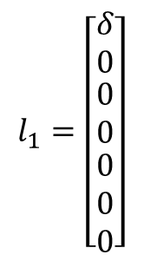

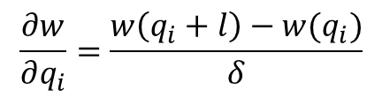
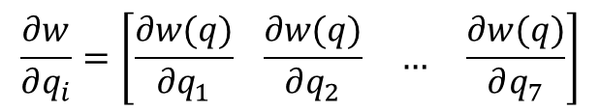

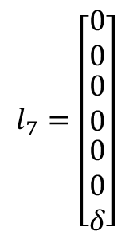
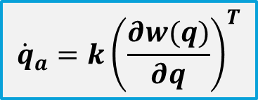
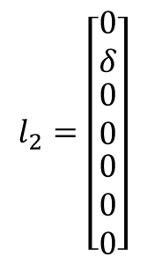
Implementation Obstacle Avoiding Control
(1)
$$d\dot{q}=J^{\text{†}}kv_{e}+\left(I−J^{\text{†}}J\right)\dot{q_{a}}$$
$$\frac{∂w}{∂q_{i}}=\left[\frac{∂w(q)}{∂q_{1}} \frac{∂w(q)}{∂q_{2}} … \frac{∂w(q)}{∂q_{7}}\right]$$
$$\frac{∂w}{∂q_{i}}=\frac{w\left(q_{i}+l\right)−w(q_{i})}{δ}$$
$${\dot{q}}_{a}=k{\left(\frac{∂w(q)}{∂q}\right)}^{T}$$
(2)
$$l_{1}=\left[\begin{matrix}δ \\ 0 \\ \begin{matrix}0 \\ 0 \\ \begin{matrix}0 \\ 0 \\ 0\end{matrix}\end{matrix}\end{matrix}\right]$$
$$l_{2}=\left[\begin{matrix}0 \\ δ \\ \begin{matrix}0 \\ 0 \\ \begin{matrix}0 \\ 0 \\ 0\end{matrix}\end{matrix}\end{matrix}\right]$$
$$l_{7}=\left[\begin{matrix}0 \\ 0 \\ \begin{matrix}0 \\ 0 \\ \begin{matrix}0 \\ 0 \\ δ\end{matrix}\end{matrix}\end{matrix}\right]$$
…
(3)
$$w(q)=min⁡||p\left(q\right)−o||$$
Distance from obstacle
p(q) – current position
o – position of obstacle
with δ<<1

Slide 10
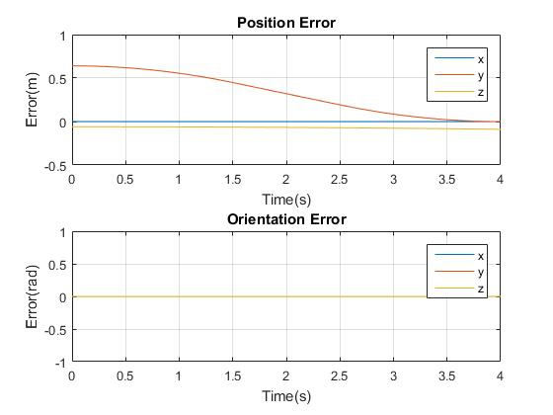
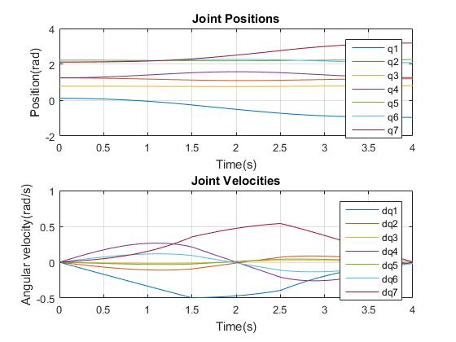
Results and Discussion Position only

Slide 11
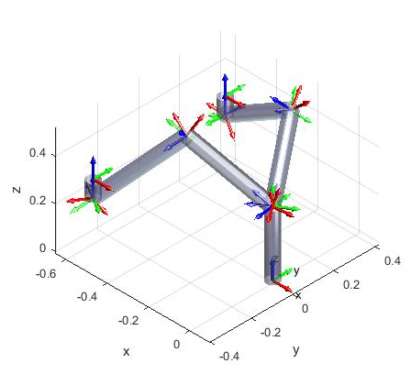
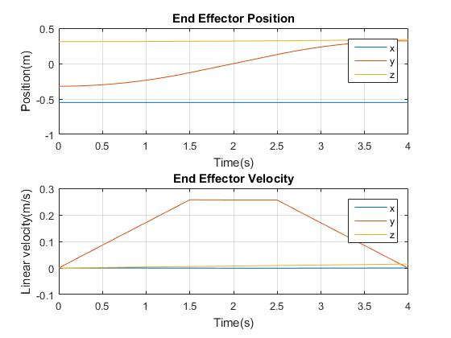
Results and Discussion Position only

Slide 12
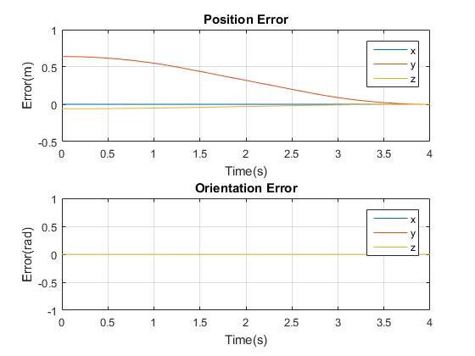
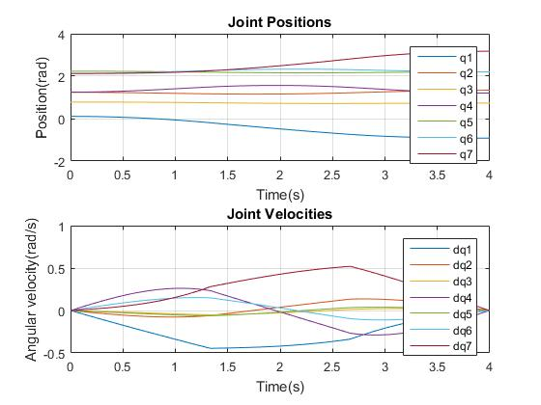
Results and Discussion Position and Orientation

Slide 13
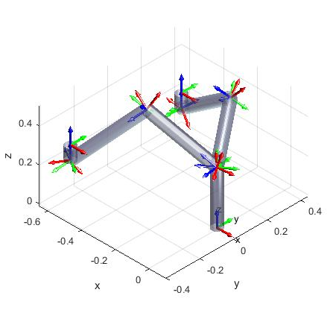
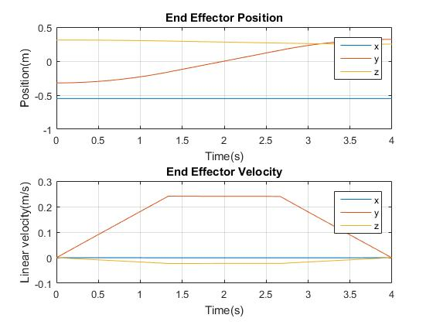
Results and Discussion Position and Orientation

Slide 14
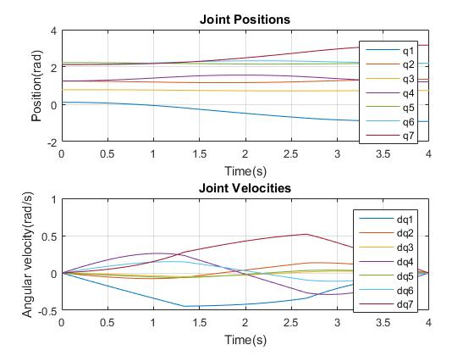
Results and Discussion Obstacle Avoiding

Slide 15

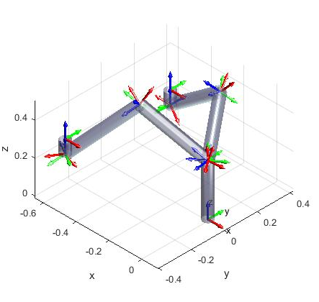
Results and Discussion Obstacle Avoiding

Slide 16
Thank you!
Demo

